Slide 1
Algorithm Analysis

Slide 2
Why we study algorithm?
Suppose computers are infinitely fast and computer memory was free. Would you have any reason to study algorithm?
  Yes, because we want to demonstrate that the algorithm is correct; it terminates with the intended solution for all inputs given
However, the reality shows that :
  Computers may be fast, but they are not infinitely fast
  Memory may be cheap, but it is not free
  Computing time and resources are therefore a bounded resources

Slide 3
Algorithm Design & Analysis Process
Understand the problem
Decide on : algorithm design techniques etc.
Decide on algorithm design techniques
Design an algorithm
Correctness
Prove correctness
Efficiency
Analyze efficiency
Code the algorithm

Slide 4
Analysis of Algorithm
As you may have noted, there are often multiple algorithms one can use to solve the same problem.
  In searching from a sequence of list, one can use linear search, binary search, …..
  For sorting a sequence of list, we may consider bubble sort, selection sort, quick sort, merge sort, heap sort,…
  You can come up with your own variants.
Why all these algorithms? Do we need them?
    How do we choose which algorithm is the best?
  The fastest/most efficient algorithm.
  The one that uses the fewest resources.
  The clearest.
  The shortest, ...

Slide 5
Analysis of algorithms
Analysis of algorithm is the analysis of resource usage of a given algorithm
  It means predicting the resources that the algorithm requires
The main resources are running time and memory usage
  An algorithm that solves a problem but requires a year and GBs of main memory is hardly of any use.
The objective of algorithm analysis is
  to measure resources (e.g., time, space) requirements of an algorithm so as to determine :-
    how quickly (with less memory) an algorithm executes in practice
An algorithm should make efficient use of computer resources
  Most frequently, we look at efficiency, i.e.
    How long does the algorithm take to run
    What is the best way to represent the running time of an algorithm?

Slide 6
Efficiency
An algorithm must solve a problem with the least amount of computational resources such as time and space.
  an algorithm should run as fast as possible using as little memory as possible
Two types of algorithmic efficiency evaluation
  Time efficiency - indicates how fast the algorithm runs
  Space efficiency - indicates how much memory the algorithm needs
What to analyze?
  To keep things simple, we will concentrate on the running time of algorithms and will not look at the space (the amount of memory) needed or required.
  So, efficiency considerations of algorithm usually focus on the amount of time elapsed (called running time of an algorithm) when processing data.

Slide 7
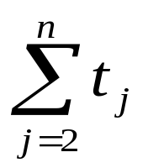
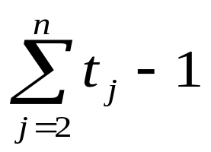
Analysis of Insertion Sort
algorithm INSERTION-SORT(A) cost times
for j ← 2 to length[A] do c₁
key ← A[j] c₂
i ← j-1 c₃
while i >0 and A[i]>key do c₄
A[i+1] ← A[i] c₅
i ← i-1 c₆
A[i+1] ← key c₇
(t_{j} is the number of times the while loop in line 4 is executed for that value of j)
The running time, T(n), of the insertion algorithm is the sum of running times for each statement executed, i.e.:
=c₁n+ c₂(n-1)+ c₃(n-1)+ c₄∑^{n}_{j=2} t_{j}+ c₅∑^{n}_{j=2} (t_{j}-1)+ c₆∑^{n}_{j=2}(t_{j}-1)+ c₇(n-1)
n
n -1
n -1
n -1

Slide 8
Best Case Analysis of Insertion Sort
Occurs if the array contains an already sorted values
  For each j = 2, 3, 4,…, n, we then find that A[i] ≤ key in line 4 when i has its initial value of j – 1.
  Thus t_{j}=1 for j = 2, 3,…, n, and line 5 and 6 will be executed 0 times
The best-case running time is
T(n) = c₁n + c₂(n-1) + c₃(n-1) + c₄(n-1) + c₇(n-1)
= (c₁ + c₂ + c₃ + c₄ + c₇)n – (c₂ + c₃ + c₄ + c₇)
  This running time can be expressed as an + b for constants a and b that depends on the statement cost c_{i};
    it is thus a linear function of n

Slide 9
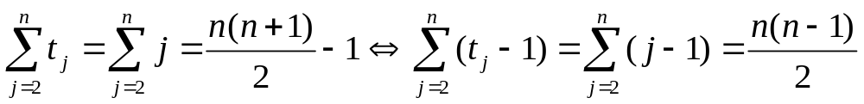
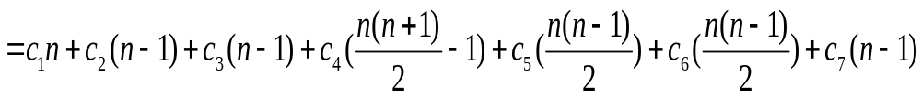
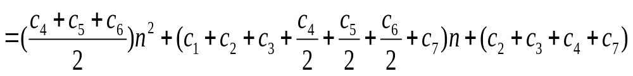
Worst Case Analysis of Insertion Sort
Occurs if the array contains values that are in reverse sorted order, that is in decreasing order
We must compare each element A[j] with each element in the entire sorted subarray A[1..j-1]. So, t_{j} = j for j = 2,3,…,n.
Therefore, the worst-case running time of INSERTION-SORT is T(n)
  This worst-case running time can be expressed as an² + bn + c for constants a, b, c, it is thus a quadratic function on n

Slide 10
Average Case Analysis of Insertion Sort
Suppose that we randomly choose n numbers and apply insertion sort
How long does it take to determine where in subarray A[1..j-1] to insert the element A[j]?
  On average, half the elements in A[1..j-1] are less than A[j], and half the elements are greater
  On average, therefore, we check half the subarray A[1..j-1], so t_{j} = j/2 and T(n) will still be in the order of n²,
This average case running time can then be expressed as quadratic function, an² + bn + c for constants a, b, c, which is the same as worst case
In summary, the running time of insertion sort for
  Best case: an – b
  Worst case: an² + bn - c
  Average case: an² + bn - c

Slide 11
Asymptotic Analysis
When analyzing the running time or space usage of programs, we usually try to estimate the time or space as a function of the input size.
  For example, when analyzing the worst-case running time of an insertion algorithm, we say the running time of insertion sort is, T(n) = an² + bn - c, for some constants a, b & c.
The asymptotic behavior of a function f(n) (such as f(n)=c*n or f(n)=c*n², etc.) refers to the growth of f(n) as n gets large. We typically ignore small values of n, since we are usually interested in estimating how slow the program will be on large inputs.
  A good rule of thumb is: the slower the asymptotic growth rate, the better the algorithm.
By this measure, a linear algorithm; f(n)=d*n+k, is always asymptotically better than a quadratic one; f(n)=c*n²+q. That is because for any given (positive) c, k, d & q there is always some n at which the magnitude of c*n²+q overtakes d*n+k.
  For moderate values of n, the quadratic algorithm could very well take less time than the linear one. However, the linear algorithm will always be better for sufficiently large inputs.

Slide 12
Asymptotic analysis
There are five notations used to describe a running time function: Big-Oh, Big-Omega, Theta, Little-o, little-omega
Demonstrating that a function T(n) is in big-O (or others) of a function f(n) requires that we find specific constants C and no for which the inequality holds
The following points are facts that can be used for efficiency comparison
1 ≤ n for all n ≥ 1 | 2^{n} ≤ n! for all n ≥ 4
n ≤ n² for all n ≥ 1 | log₂^{n} ≤ n for all n ≥ 2
n ≤ nlog₂^{n} for all n ≥ 2

Slide 13
Asymptotic notations: Big-Oh (O)
Definition
  Let f(n) and g(n) be functions mapping nonnegative integers to real numbers.
  A function f(n) = O(g(n)), if there is some positive constant c > 0 and a non-negative integer n_{o} ≥ 1 such that
  f(n) ≤ c.g(n) for all n ≥ n_{o}
Big-O expresses an upper bound on the growth rate of a function, for sufficiently large values of n
  An upper bound is the best algorithmic solution that has been found for a problem (“what is the best thing that we know we can do?”)
In simple words, f(n) = O(g(n)) means that the growth rate of f(n) is less than or equal to g(n).
  The statement f(n) = O(g(n)) states only that c.g(n) is un upper bound on the value of f(n) for all n, n ≥ n₀

Slide 14
Big-Oh theorems
Theorem 1: If k is a constant, then k is O(1)
  Example: f(n) = 2¹⁰⁰ = O(1)
Theorem 2: If f(n) is a polynomial of degree k, then
f(n) = O(n^{k})
  If f(n) = a₀+ a₁n + a₂n² + … + a_{k}n^{k}, where a_{i} and k are constants, then f(n) is in O(n^{k})
  Polynomial’s growth rate is determined by the leading term
    Example: f(n) = 7n⁴ + 3n² + 5n + 1000 is O(n⁴)
Theorem 3: Constant factors may be ignored
If g(n) is in O(f(n)), then k * g(n) is O(f(n)), k >0
    Example:
    T(n) = 7n⁴ +3n² + 5n +1000 is O(n⁴)
    T(n) = 28n⁴ + 12n² + 20n + 4000 is O(n⁴)

Slide 15
Big-Oh theorems
Theorem 4 (Transitivity)
  If T(n) is O(f(n))and f(n) is O(g(n)), then T(n) is O(g(n)).
Theorem 5
If T(n) is in O(f(n)) and g(n) is in O(h(n)), then T(n) + g(n) is in O(T(n) + g(n))
sum of upper bounds is upper bound for the sum
Theorem 6
If T(n) is in O(f(n)) and g(n) is in O(h(n)), then T(n) . g(n) is in O(T(n) . g(n))
product of upper bounds is upper bound for the product
Theorem 7
If f₁(n) = O(g₁(n)) and f₂(n) = O(g₂(n)), then f₁(n) + f₂(n) = O(max(g₁(n), g₂(n))

Slide 16
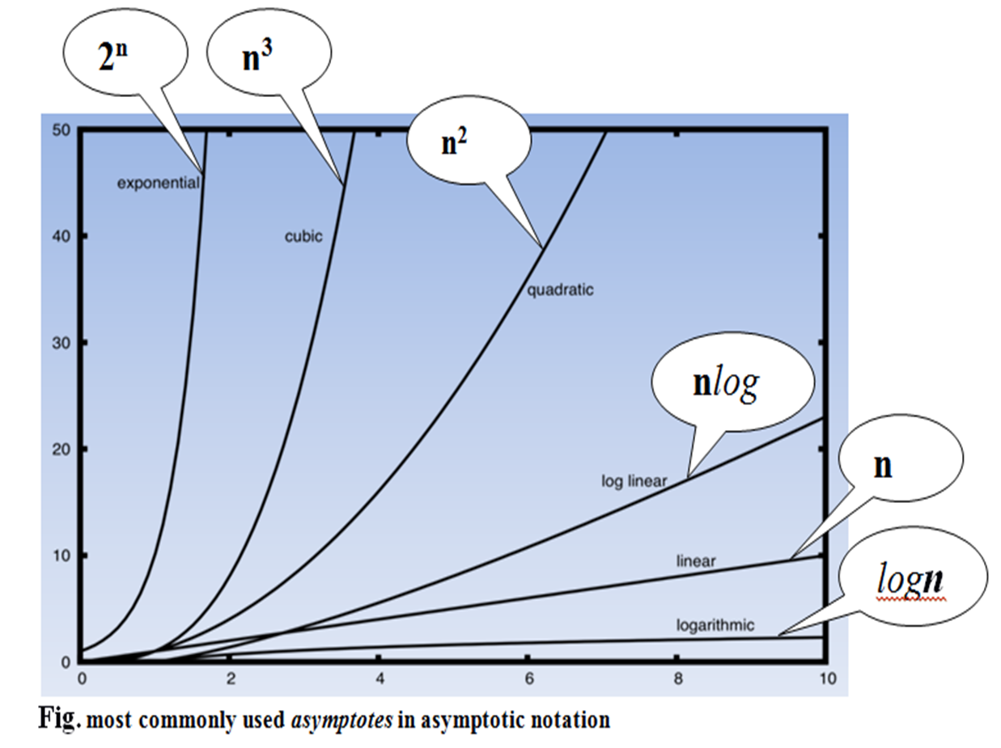
Order of growth of functions

Slide 17
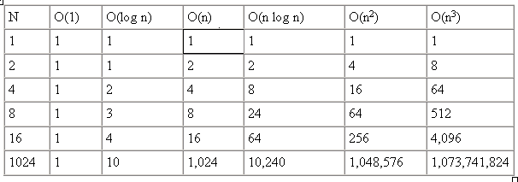
Order of growth of functions
Typical orders: Here is a table of some typical cases. It shows that the typical orders is:
O(1) < O(log n) < O(n) < O(nlog n) < O(n²) < O(n³) < O(2^{n})

Slide 18
Example: Big-Oh (O)
Find O(f(n) for the given functions:
f(n) = 2n + 6
f(n) = 13n³ + 42n² + 2n log n
If f(n) = 3n² + 4n + 1 then show that f(n) = O(n²)
If f(n) = 10n + 5 and g(n) = n, then show that f(n) is O(g(n))

Slide 19
Asymptotic notations: Big-Omega (Ω)
Definition
  Let f(n) and g(n) be functions mapping nonnegative integers to real numbers.
  A function f(n) = Ω(g(n)), if there is some positive constant c > 0 and a negative integer n_{o} ≥ 1 such that
  f(n) ≥ c.g(n) for all n ≥ n_{o}
The statement f(n) = Ω(g(n)) states only that c.g(n) is a lower bound on the value of f(n) for all n, n ≥ n₀
  In simple terms, f(n) = Ω(g(n)) means that the growth rate of f(n) is greater than or equal to g(n)

Slide 20
Big-Omega- Example
Show that the function T(n) = 5n² – 64n + 256 = Ω(n²)
  We need to show that for non-negative integer n₀ and a constant c > 0, T(n) ≥ c.n² for all integers n ≥ n₀
  we have that for c=1 and n₀ = 0, T(n) ≥ cn² for all integers n ≥ n₀
  What if c = 2 and n₀ = 16 ?
Show if f(n) = 10n² + 4n + 2 and g(n) = n² , then f(n) = Ω(n²)
Show that 3n² + 5 ≠ Ω(n³)

Slide 21
Asymptotic notations: Theta (Θ)
Definition
  Let f(n) and g(n) be functions mapping nonnegative integers to real numbers.
  A function f(n) = Θ(g(n)), if there exist some positive constant c₁ and c₂ and a negative integer constant n_{o} ≥ 1 such that c₁.g(n) ≤ f(n) ≤ c₂.g(n) for all n ≥ n_{o}
The Theta notation is used when the function f can be bounded both from above and below by the same function
  When we write f(n) = Θ(g(n)), we mean that f lies between c₁ times the function g and c₂ times the function g except possibly when n is smaller than n₀
Another way to view the θ-notation is that the function
  f(n) = θ(n) if and only if
  f(n) = Ο(g(n)) and f(n) = Ω(g(n))

Slide 22
Asymptotic Tightness
The theta notation is more precise than both the Big-O and Big-Ω notations.
  The function f(n) = Θ(g(n)) iff g(n) is both an upper and lower bounds on f(n).
Big-Oh does not have to be asymptotically tight
  f(n) = ½n is O(n) with c=1, n₀=1, but is also in O(n¹⁰⁰)…
Big-Ω isn’t tight either
  f(n) = n⁵ is Ω(n) with c=1, n₀ = 1…
Theta (Θ) is tight…
  f(n) must be in same growth classes to meet definition.
  Can you prove this assertion? Prove that f(n)=3n³+2n²+1 is Θ(n³).
Show that f(n) is O(n³), and also, f(n) is Ω(n³)

Slide 23
Exercise: Algorithmic efficiency
What is the best, worst and average case time complexity of Insertion sort algorithms?
Write (i) an algorithm for linear search and (ii) analyze its time complexity, which scans through the given sequence of inputs, A = <a1, a2, …, an>, looking for Key.
The output is either
  One or more index i (the position of all values if key = A[i]) or
  the special message “Not Found” if Key does not appear in the list.
Write (i) an algorithm and (ii) a code that scans through the given sequence of inputs, A = <a1, a2, …, an>, finding for one or more minimum value(s).

